Slide 1
Lecture 2
Platform 0 revisited
Computing platforms, semester 2
Novosibirsk State University
University of Hertfordshire
D. Irtegov, A.Shafarenko
2019

Slide 2
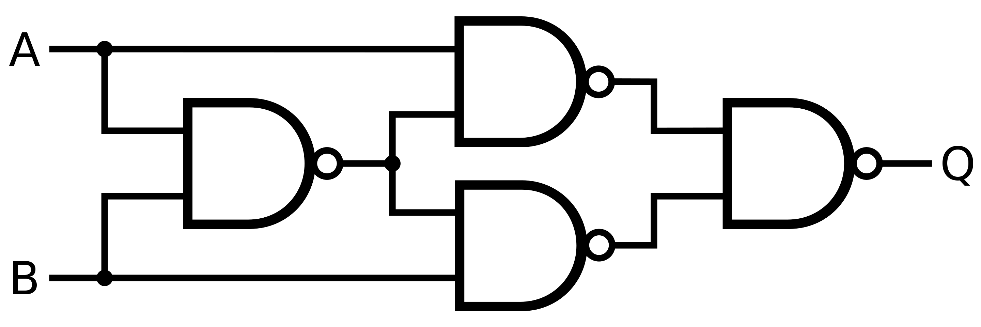
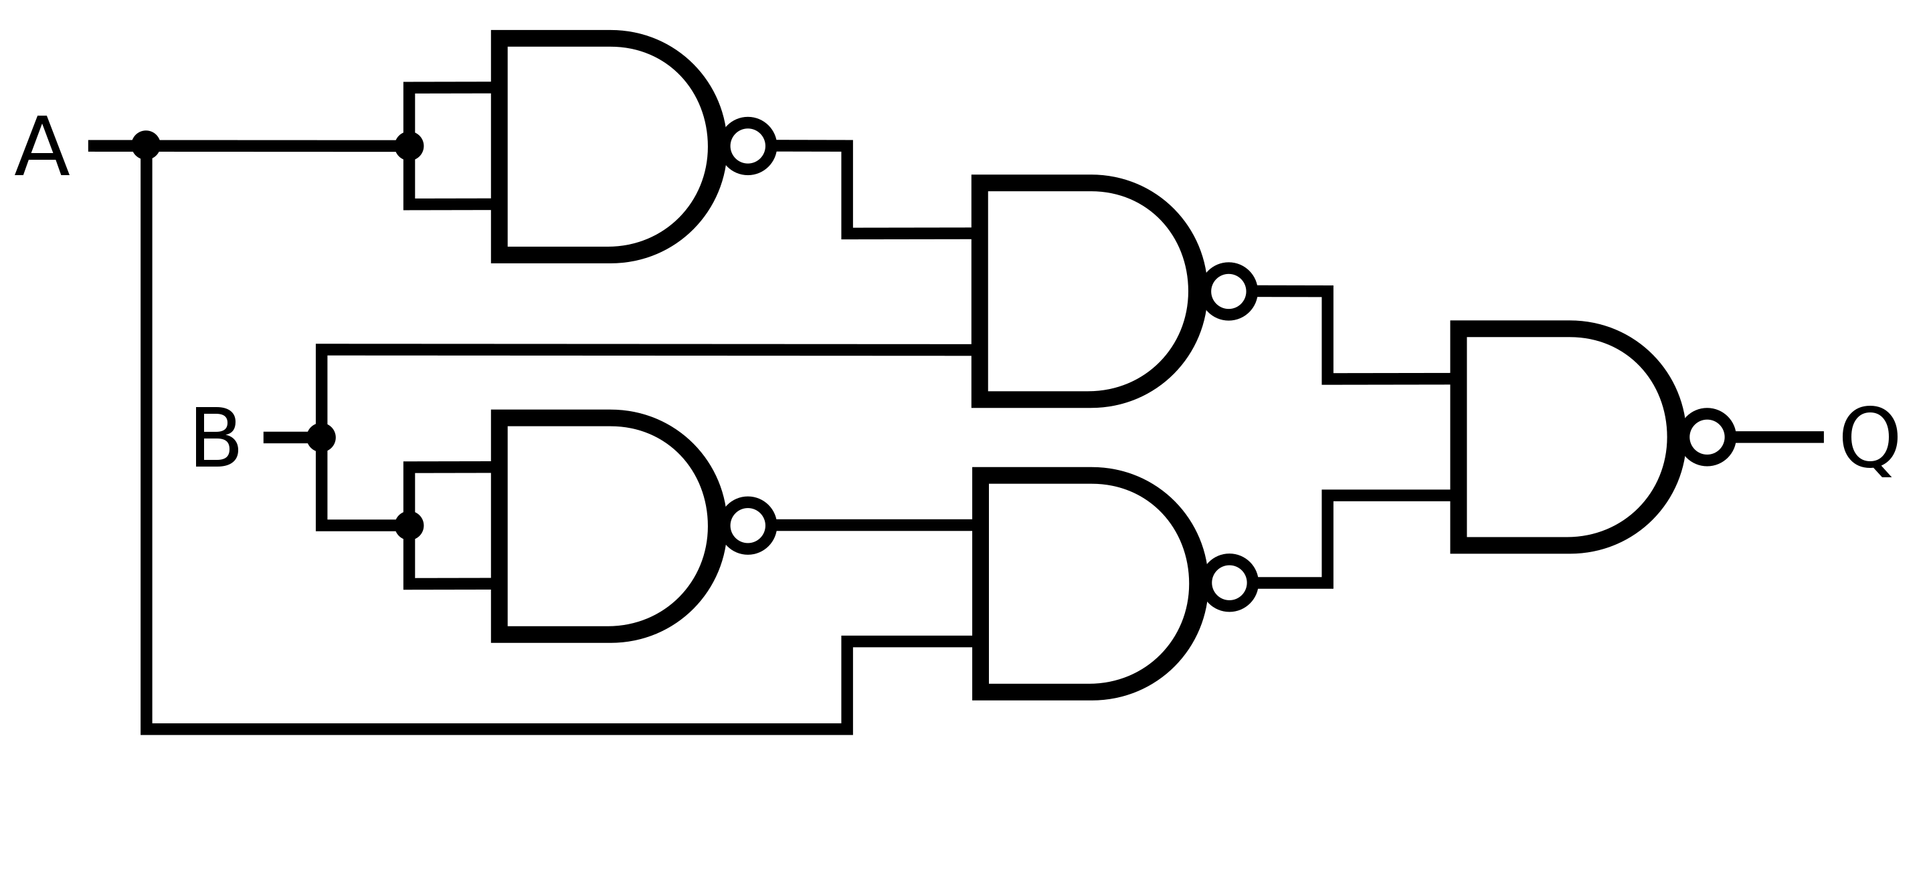
XOR gate
4 NAND gates * 4 transistors each = 16 transistors

Slide 3
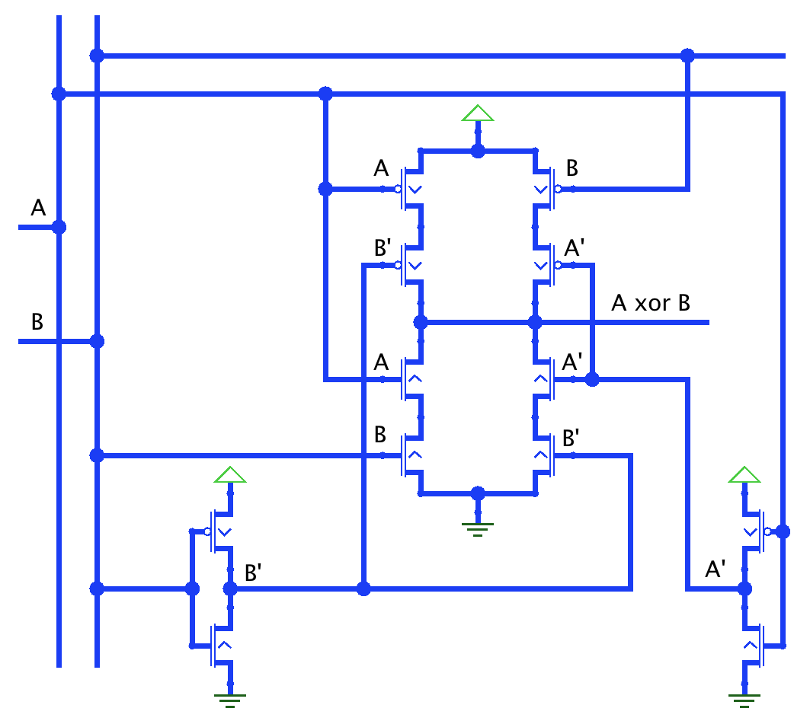
XOR gate optimized on transistor level
At the core, we have symmetrical circuit which is not equivalent to one of basic gates
To have output=1, we need one of upper pairs open:
(A&B’=1 | A’&B=1)
To have output=0, we need one of lower pairs open:
(A&B=1 | A’&B’=1)
12 transistors

Slide 4
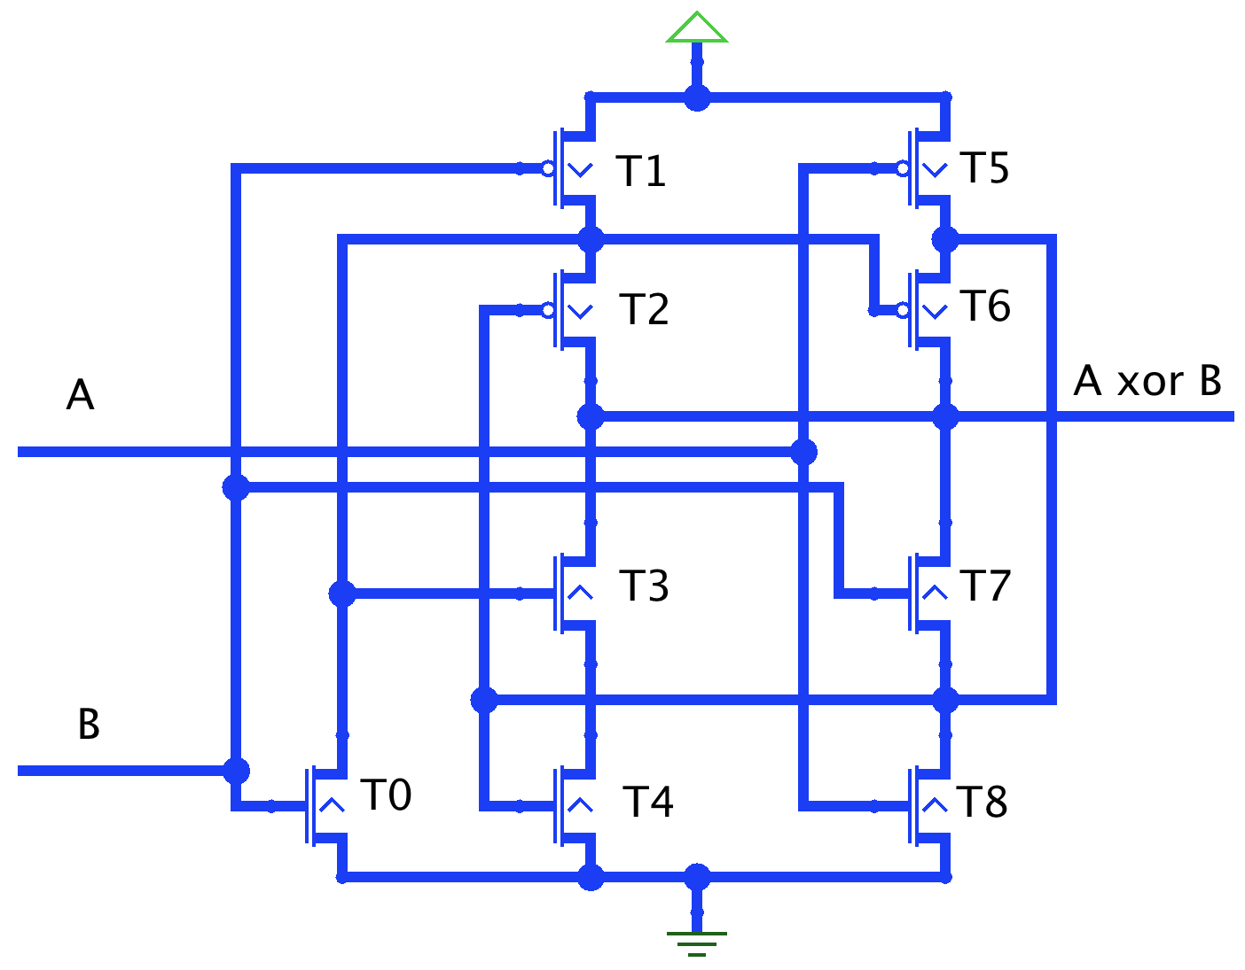
XOR gate optimized: second try
Much harder to understand

Slide 5


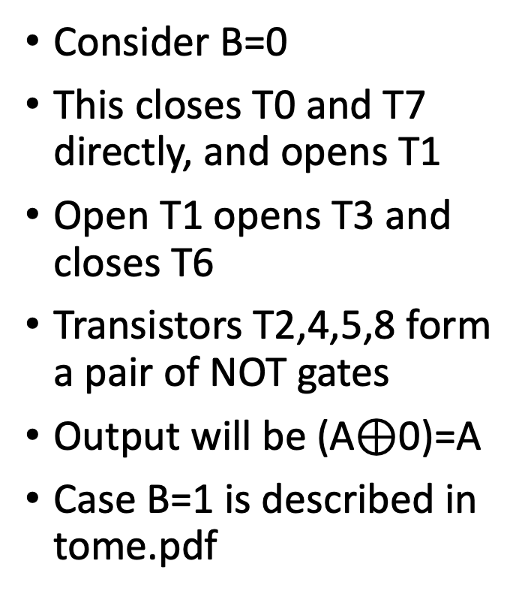
How it works?
Consider B=0
This closes T0 and T7 directly, and opens T1
Open T1 opens T3 and closes T6
Transistors T2,4,5,8 form a pair of NOT gates
Output will be (A$⊕$0)=A
Case B=1 is described in tome.pdf

Slide 6
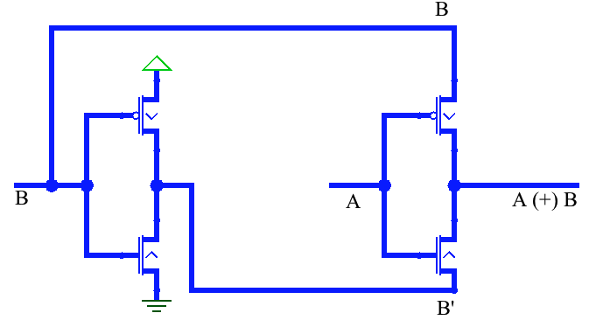
Pass transistor logic (PTL)

Slide 7
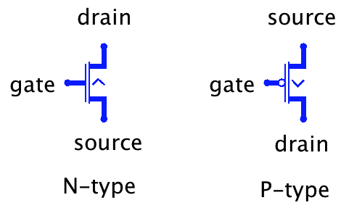
Floating signals
N-type truth table
P-type truth table
Generally, you should avoid floating input on transistor gates
Also, you should avoid connecting conflicting outputs
But connecting floating output to non-floating one is OK
Actually, NOT gate uses exactly this kind of connection

Slide 8
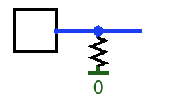
Pull resistor
Gives sort of default value to circuit output
I.e. when output floats, pull resistor pulls it to 0
If we connect it to PWR, it will pull it to 1

Slide 9
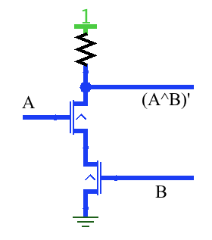
NAND gate using pull resistor

Slide 10
Why not use pull resistors everywhere?
They are slow
They consume power

Slide 11
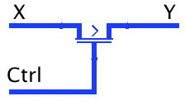
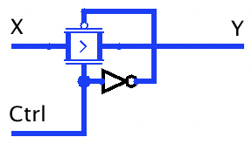
Controlled buffer
This device allows to controllably pass X to Y
Actual buffers are bidirectional (signal and even floating value passes also from Y to X)
But Logisim simulates them as unidirectional
Smarter implementation known as transmission gate
Less signal degradation

